Slide 1
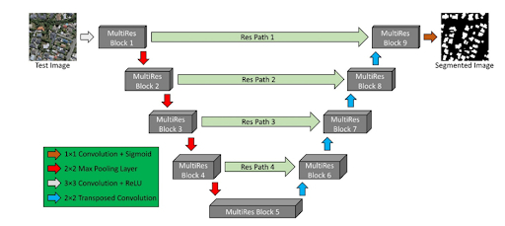
MODULE I: BUILDING DETECTION
Annotate Rooftop Types
PRE-PROCESSING
MODULE II: ROOFTOP CLASSIFICATION & BOUNDARY DETECTION
Clipping of images
Resizing & Normalization
Shallow CNN
ResNet50
EfficientNetB4
MULTIRES UNET
Majority voting
AIRS DATASET
EXTRACTED ROOFTOPS
BOUNDARY DETECTION
White balancing
Fuzzy Histogram Hyberbolization
Gaussian blur
ROOF TYPE WITH EDGE DETECTED ROOFTOP
MODULE III: MAXIMAL MODULE FITTING
Background subtraction with color filling algorithm
Superimpose module grid on roof
Perform module fitting in landscape
Flat
CLASSIFIED ROOF TYPE WITH GUESSTIMATED NO OF PANELS
Tilted
Perform module fitting in landscape & portrait

